Slide 1
Computer Graphics And Multimedia Applications SCS1302
Unit 4

Slide 2
VISIBLE SURFACE DETECTION METHODS
When we view a picture containing non-transparent objects and surfaces, then we cannot see those objects from view which are behind from objects closer to eye. We must remove these hidden surfaces to get a realistic screen image. The identification and removal of these surfaces is called Hidden-surface problem.

Slide 3
VISIBLE SURFACE DETECTION METHODS
Why we need visible space detection
To generate realistic graphics displays.
To determine what is visible within a scene from a chosen viewing position.
For 3D worlds, this is known as visible surface detection or hidden surface elimination.
So many methods and algorithms are available.
Some require more memory space, some require more processing time.
Which method? For which application? Depends on which object to be displayed, available equipment, complexity of the scene, etc..

Slide 4
Basic classification
Two basic classifications –based on either an object or projected image , which is going to be displayed
Object-space Methods- compares objects and parts of objects to each other within a scene definition to determine which surfaces are visible
Image-space Methods- visibility is determined point-by-point at each pixel position on the projection plane

Slide 5
Object Space Method | Image Space Method
Compares objects and parts of objects to each other within a scene definition to determine which surfaces are visible | visibility is determined point-by-point at each pixel position on the projection plane
Used by Vector Graphic System | Raster Scan System
High Accuracy | Less amount of processing time

Slide 6
Back-face detection
Object Space Method.
To find the back faces of a polyhedron.
Consider a polygon surface with parameters A,B,C and D.
A point (x,y,z) is inside the polyhedrons’ back face only if
Ax+By+Cz+D<0
We can simply say that the z component of the polygon’s normal is less than zero, then the point is on the back face.

Slide 7
Back-face detection
We can simply say that the z component of the polygon’s normal is less than zero, then the point is on the back face.

Slide 8
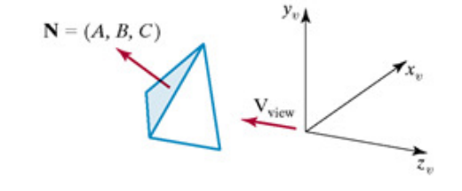
Back-face detection

Slide 9
Back-face detection
If we take V as the vector in the viewing direction from the eye and N as the normal vector to the polygon’s surface, then we can state the condition as
V.N>0
then that face is the back face.
It eliminates about half of the polygon surfaces in a scene from further visibility tests.

Slide 10
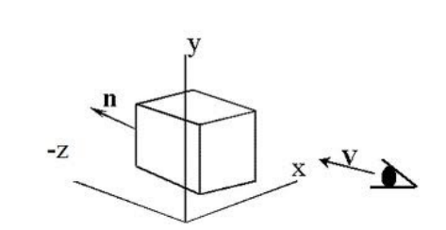
Back-face detection

Slide 11
Depth buffer method or z-buffer method
It is an image-space approach. The basic idea is to test the Z-depth of each surface to determine the closest visible surface
In this method each surface is processed separately one pixel position at a time across the surface. The depth values for a pixel are compared and the closest smallest surface determines the color to be displayed in the frame buffer.

Slide 12
Z- buffer
Assign a z-value to each polygon and then display the one (pixel by pixel) that has the smallest value.

Slide 13
Depth buffer method or z-buffer method
Depth buffer algorithm requires 2 arrays, intensity and depth each of which is indexed by pixel coordinates (x, y).
It is applied very efficiently on surfaces of polygon. Surfaces can be processed in any order. To override the closer polygons from the far ones, two buffers named frame buffer and depth buffer, are used.
Depth buffer is used to store depth values for x,y position, as surfaces are processed 0≤depth≤1 .
The frame buffer is used to store the intensity value of color value at each position x,yx,y
The z-coordinates are usually normalized to the range [0, 1]. The 0 value for z-coordinate indicates back clipping pane and 1 value for z-coordinates indicates front clipping pane

Slide 14
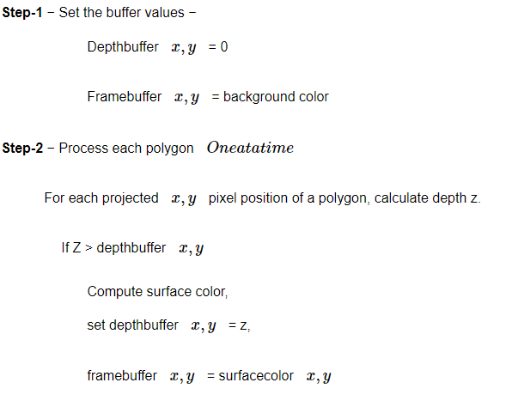
Algorithm

Slide 15
If z > depth [x, y], this polygon is closer to the observer than others already recorded for this pixel.
In this case, set depth [x, y] to z and intensity [x, y] to a value corresponding to polygon's shading.
If instead z < depth [x, y], the polygon already recorded at (x, y) lies closer to the observer than does this new polygon, and no action is taken.

Slide 16
Depth buffer method or z-buffer method
Advantages
It is easy to implement.
It reduces the speed problem if implemented in hardware.
It processes one object at a time.
Disadvantages
It requires large memory.
It is time consuming process.

Slide 17
A-buffer Method
Extension of Depth-buffer -> accumulation buffer(A-Buffer)
A- Antialiased, Area-averaged, Accumulation – Buffer.
Drawback of Depth-buffer-can find one visible surface at each pixel position. Cannot accumulate intensity values for more than one surface. Each buffer position can reference a linked-list of surfaces.

Slide 18
A-buffer Method
Each position has 2 fields.
Depth field – stores a positive or negative real number
Intensity field- stores surface intensity information or a pointer value.
If depth is >= 0(single surface), then the surface data field stores the depth of that pixel position as before
If depth < 0 (multiple surfaces)then the data filed stores a pointer to a linked list of surface data.

Slide 19
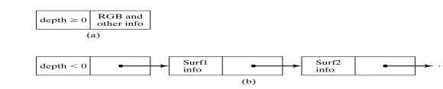
A-buffer Method

Slide 20
Scan-Line Method
It is an image-space method to identify visible surface.
This method has a depth information for only single scan-line.
In order to require one scan-line of depth values, we must group and process all polygons intersecting a given scan-line at the same time before processing the next scan-line

Slide 21
Scan-Line Method
Two important tables, edge table and polygon table, are maintained for this.
The Edge Table − It contains coordinate endpoints of each line in the scene, the inverse slope of each line, and pointers into the polygon table to connect edges to surfaces.
The Polygon Table − It contains the plane coefficients, surface material properties, other surface data, and may be pointers to the edge table.

Slide 22
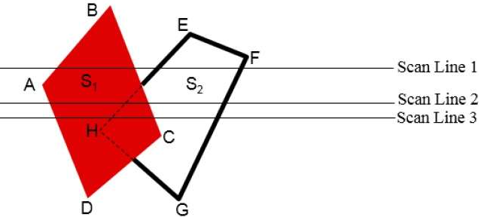
Scan-Line Method

Slide 23
Scan-Line Method
To facilitate the search for surfaces crossing a given scan-line, an active list of edges is formed. It is stored in an active edge table
The active list stores only those edges that cross the scan-line in order of increasing x.
Also a flag is set for each surface to indicate whether a position along a scan-line is either inside or outside the surface.

Slide 24
Scan-Line Method
Pixel positions across each scan-line are processed from left to right.
You only need to perform depth calculations when multiple surfaces have their flags turned on at a certain scan-line position.

Slide 25

A Painter's Algorithm
The painter's algorithm, sometimes called depth-sorting, gets its name from the process which an artist renders a scene using oil paints. First, the artist will paint the background colors of the sky and ground. Next, the most distant objects are painted, then the nearer objects, and so forth. Note that oil paints are basically opaque, thus each sequential layer completely obscures the layer that its covers.
A very similar technique can be used for rendering objects in a three-dimensional scene. First, the list of surfaces are sorted according to their distance from the viewpoint. The objects are then painted from back-to-front.
While this algorithm seems simple there are many subtleties. The first issue is which depth-value do you sort by? In general a primitive is not entirely at a single depth. Therefore, we must choose some point on the primitive to sort by.

Slide 26
Depth- sorting or painter’s algorithm
Sort the objects by distance from the viewer.
Draw objects in order from farthest to nearest.
Nearer objects will “overwrite” farther ones
If 2 objects DO overlap
Need to find a plane to split one polygon by so that each new polygon is entirely in front of or entirely behind the other
Polygons may actually intersect, so then need to split each polygon by other.

Slide 27
painter’s algorithm
Step1: Start Algorithm
Step2: Sort all polygons by z value keep the largest value of z first.
Step3: Scan converts polygons in this order. Test is applied
Does A is behind and non-overlapping B in the dimension of Z as shown in fig (a)
Does A is behind B in z and no overlapping in x or y as shown in fig (b)
If A is behind B in Z and totally outside B with respect to view plane as shown in fig (c)
If A is behind B in Z and B is totally inside A with respect to view plane as shown in fig (d)
The success of any test with single overlapping polygon allows F to be painted.

Slide 28
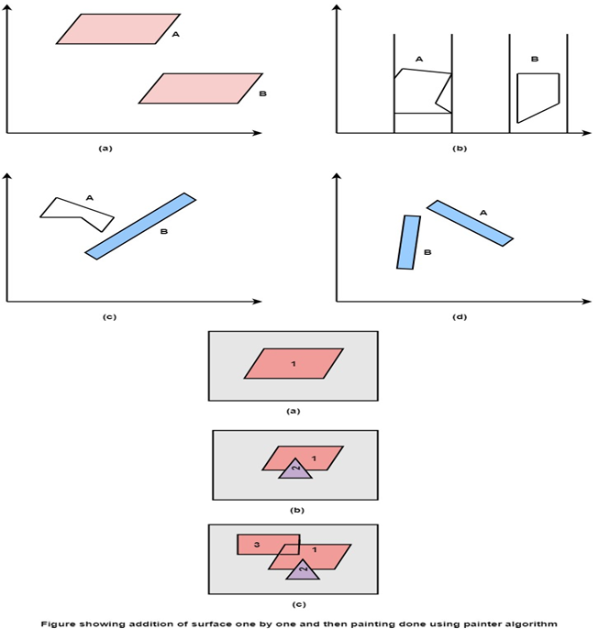

Slide 29
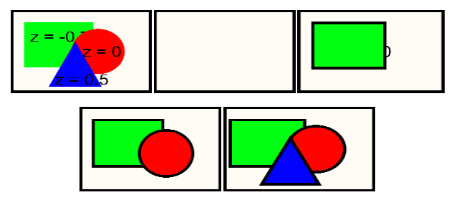

Slide 30
BSP Tree Method
A BSP (Binary Space-Partitioning) tree is formed by first choosing a triangle from the set of all triangles in the scene.
The plane that contains this triangle is called P. Classify all other triangles into two groups. One group in front of P, and the other group behind P. All triangles that are intersected by P are split into multiple smaller triangles, each of which is either in front of P or behind P
Within each group, recursively pick another triangle and partition all these triangles in this group into two sub-groups
Do this until there is only one triangle in each group.
The result is a tree

Slide 31
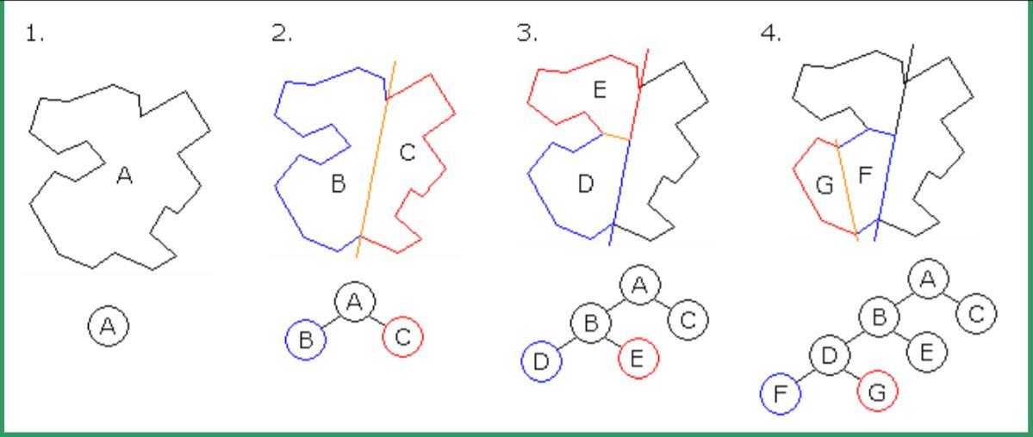

Slide 32
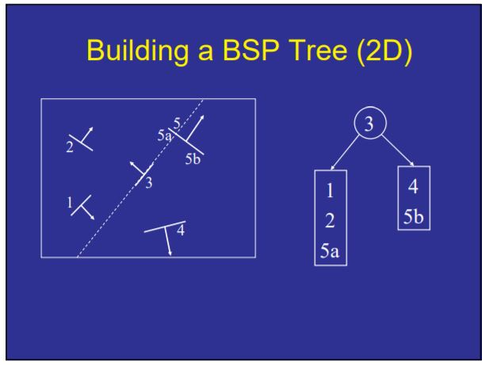

Slide 33
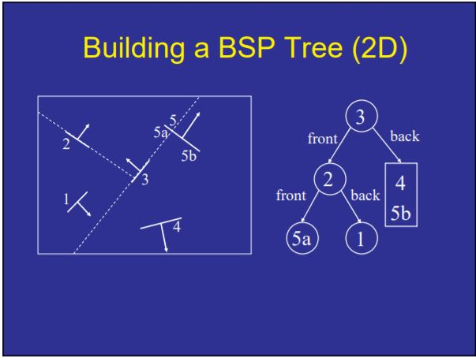

Slide 34
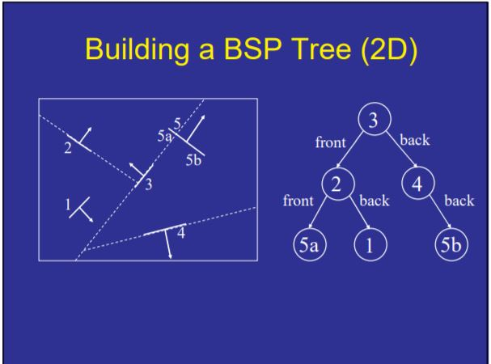

Slide 35
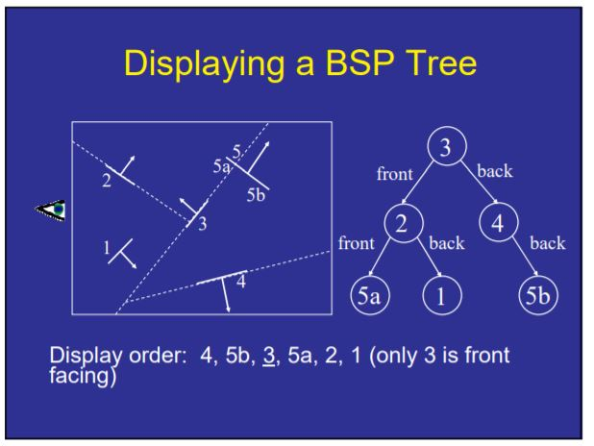

Slide 36
Area Subdivision Method
The area subdivision method takes advantage of area coherence in a scene by locating those view areas that represents part of a single surface.
The total viewing area is successively divided into smaller and smaller rectangles until each small area is simple, ie. it is a single pixel, or is covered wholly by a part of a single visible surface or no surface at all.

Slide 37
The procedure to determine whether we should subdivide an area into smaller rectangle is:
1. We first classify each of the surfaces, according to their relations with the area:
Surrounding surface - a single surface completely encloses the area
Overlapping surface - a single surface that is partly inside and partly outside the area
Inside surface - a single surface that is completely inside the area
Outside surface - a single surface that is completely outside the area.

Slide 38
To improve the speed of classification, we can make use of the bounding rectangles of surfaces for early confirmation or rejection that the surfaces should be belong to that type.
2. Check the result from 1., that, if any of the following condition is true, then, no subdivision of this area is needed.
a. All surfaces are outside the area.
b. Only one surface is inside, overlapping or surrounding surface is in the area.
c. A surrounding surface obscures all other surfaces within the area boundaries.
For cases b and c, the color of the area can be determined from that single surface.

Slide 39
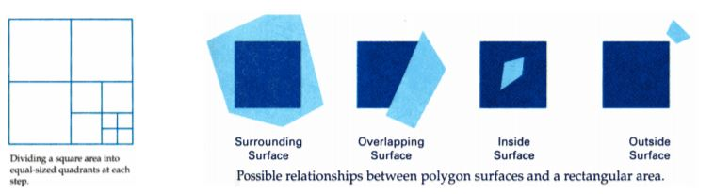

Slide 40
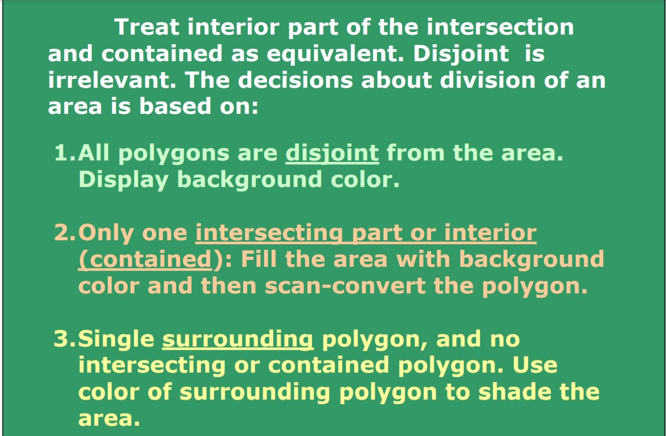

Slide 41
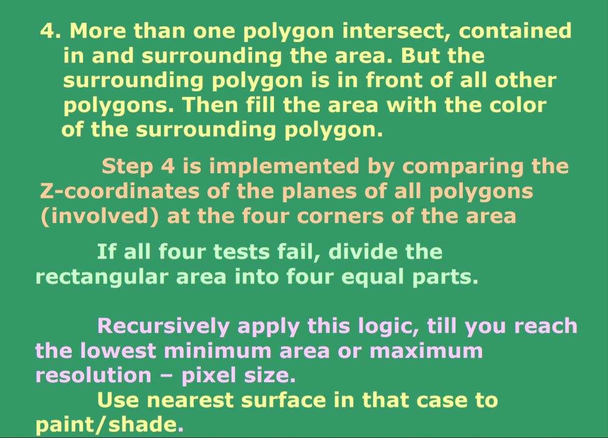

Slide 42
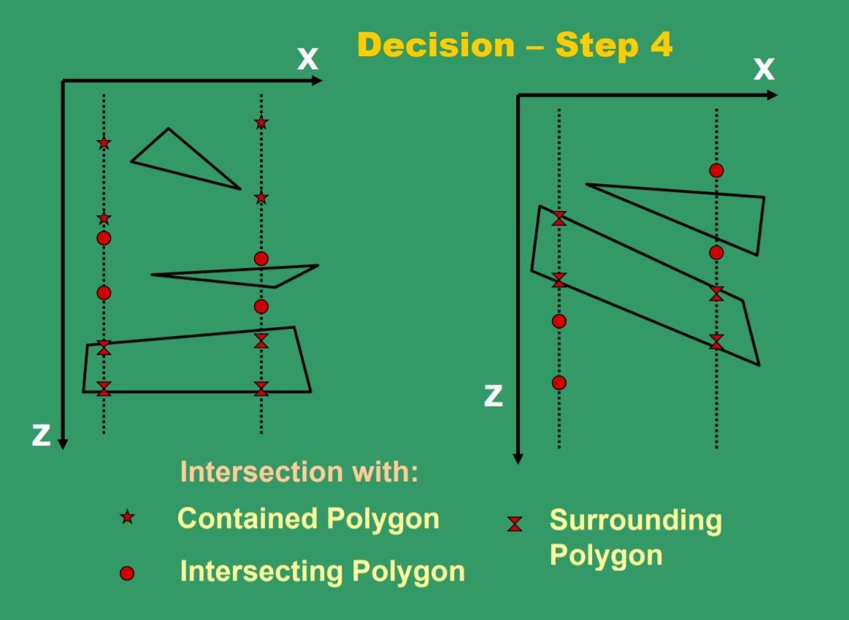

Slide 43
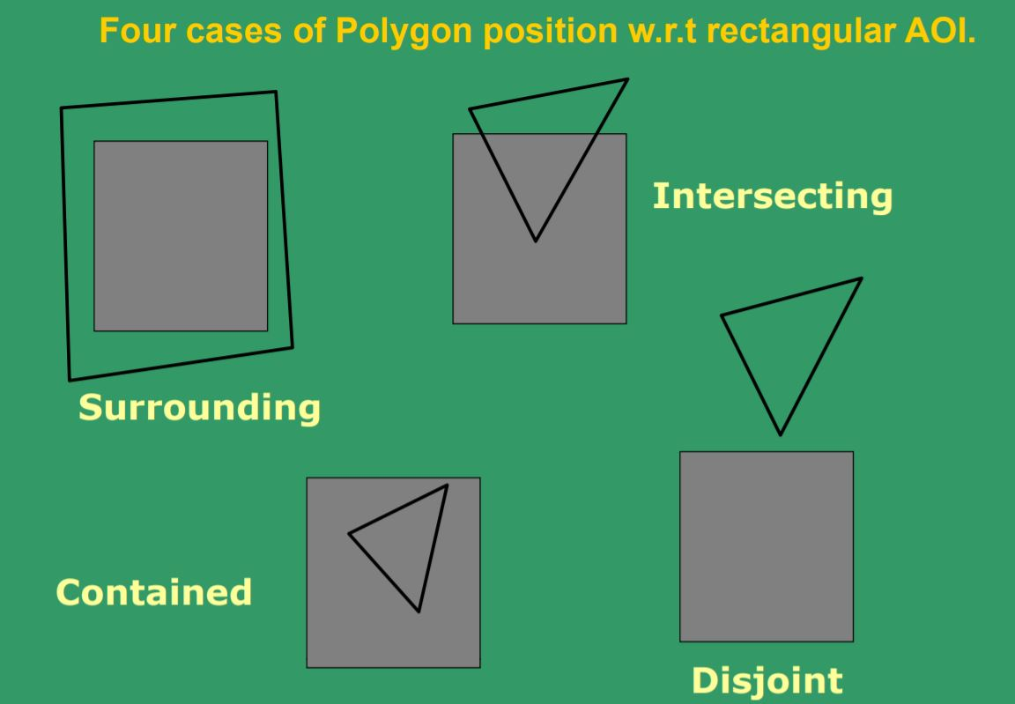

Slide 44
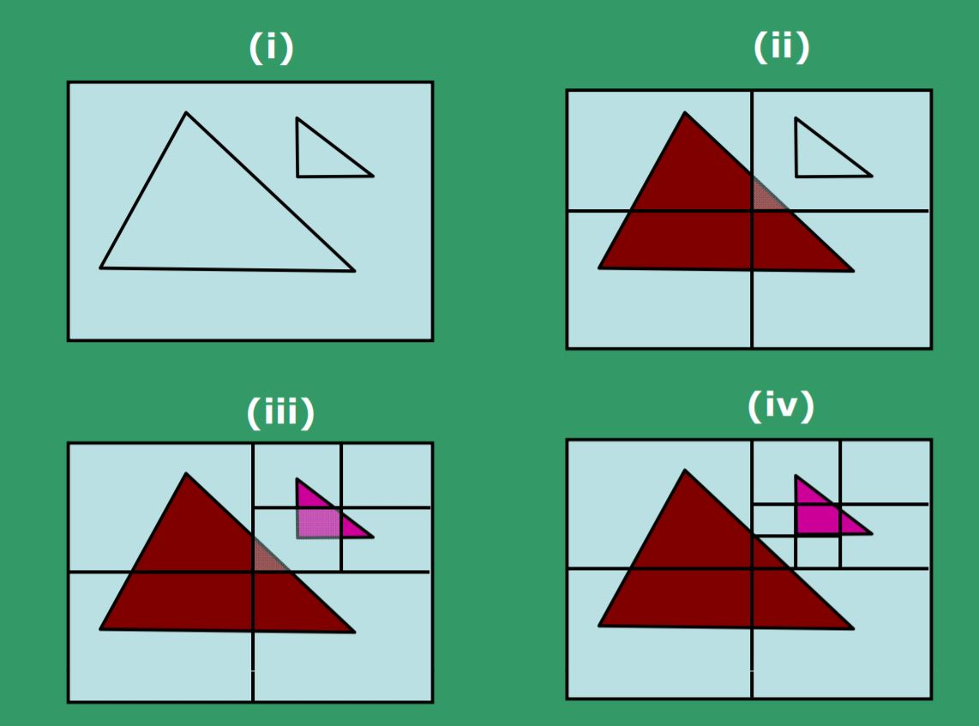
Example of Area subdivision method

Slide 45
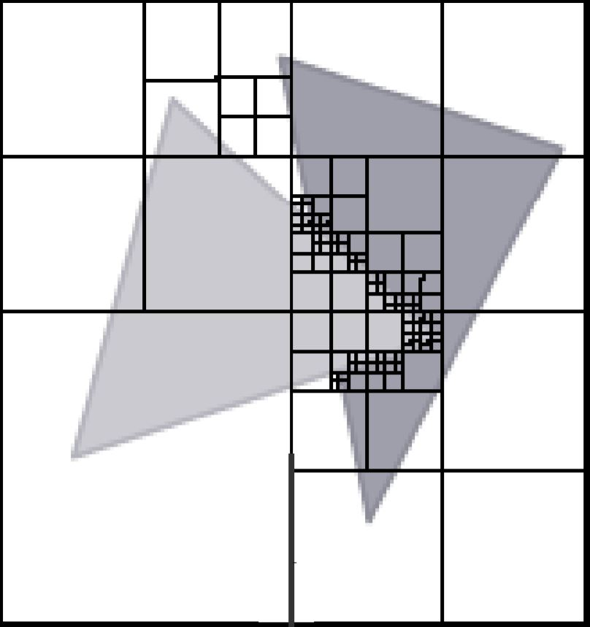

Slide 46
Octree Methods
In these methods, octree nodes are projected onto the viewing surface in a front-to back order.
With the numbering method (0,1,2,3,4,5,6,7), nodes representing octants 0,1,2,3 for the entire region are visited before the nodes representing octants 4,5,6,7.
Similarly the nodes for the front four sub- octants of octant 0 are visited before the nodes for the four back sub- octants.

Slide 47
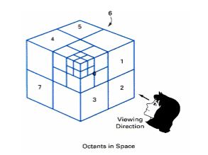
When a color is encountered in an octree node, the corresponding pixel in the frame buffer is painted only if no previous color has been loaded into the same pixel position.

Slide 48
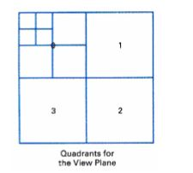
In most cases, both a front and a back octant must be considered in determining the correct color values for a quadrant.

Slide 49
But
- If the front octant is homogeneously filled with some color, we do not process the back octant.
- If the front is empty, it is necessary only to process the rear octant.
- If the front octant has heterogeneous regions, it has to be subdivided and the sub-octants are handled recursively

Slide 50
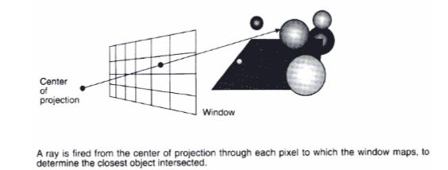
Ray Casting Method
The intensity of a pixel in an image is due to a ray of light, having been reflected from some objects in the scene, pierced through the centre of the pixel.

Slide 51
So, visibility of surfaces can be determined by tracing a ray of light from the centre of projection (viewer's eye) to objects in the scene. (backward-tracing).
Find out which objects the ray of light intersects.
Then, set the pixel color to this object.
The ray-casting approach is an effective visibility-detection method for scenes with curved surfaces, particularly spheres.

Slide 52
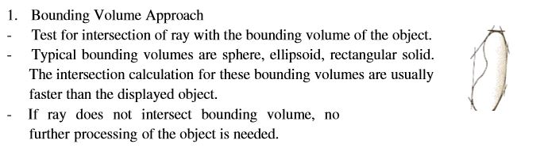
Speeding up the intersection calculation in ray tracing
For 1024x1024 pixels image and 100 objects in the scene, total number of object intersection calculations is about 100 millions.

Slide 53
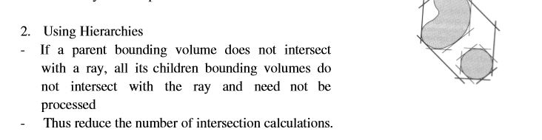
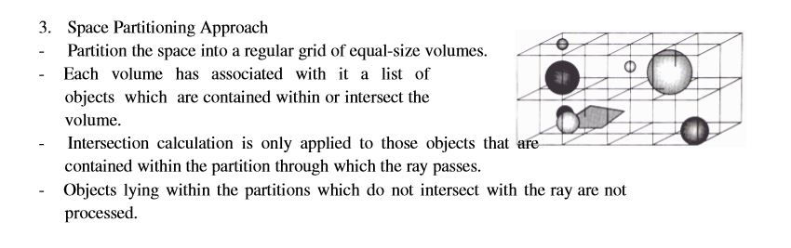

Slide 54
Summary and Comparison
The most appropriate algorithm to use depends on the scene
depth-sort is particularly suited to scene with objects which are spread out along z-axis and/or with a small number of objects => rarely overlap in depth
scan-line and area subdivision algorithms are suitable to scene where objects are spread out horizontally and/or scene with small number of objects ( about several thousand surfaces).

Slide 55
Summary and Comparison
Z-buffer and subdivision algorithms perform best for scene with fewer than a few thousand surfaces.
Octree is particularly good because it does not require any pre-sorting or intersection calculations.
If parallel processing hardware is available, ray tracing would be a good choice (each processor handles a ray).

Slide 56
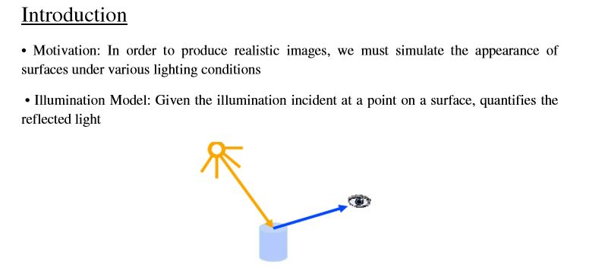
ILLUMINATION MODELS

Slide 57
Illumination Model Parameters
Lighting effects are described with models that consider the interaction of light sources with object surfaces
The factors determining the lighting effects are:
– The light source parameters:
• Positions
• Electromagnetic Spectrum
• Shape
– The surface parameters
• Position
• Reflectance properties
• Position of nearby surfaces
– The eye (camera) parameters
• Position
• Sensor spectrum sensitivities

Slide 58
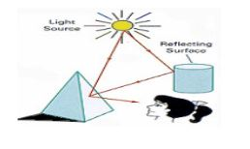
Illumination Models and Rendering
An illumination model is used to calculate the intensity of the light that is reflected at a given point on a surface .
A rendering method uses intensity calculations from the illumination model to determine the light intensity at all pixels in the image

Slide 59
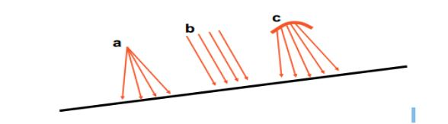
Light Source Models
Point Source (a): All light rays originate at a point and radially diverge. A reasonable approximation for sources whose dimensions are small compared to the object size
Parallel source (b): Light rays are all parallel. May be modeled as a point source at infinite distance (the sun)
Distributed source (c): All light rays originate at a finite area in space. It models a nearby source, such as a fluorescent light

Slide 60
Simplified and fast methods for calculating surfaces intensities, mostly empirical
Calculations are based on optical properties of surfaces and the lighting conditions (no reflected sources nor shadows)
Light sources are considered to be point sources
Reasonably good approximation for most scenes

Slide 61
Simple Illumination Model
Surfaces in real world environments receive light in 3 ways:
1. Directly from existing light sources such as the sun or a lit candle
2. Light that passes and refracts through transparent objects such as water or a glass vase
3. Light reflected, bounced, or diffused from other existing surfaces in the environment

Slide 62
Diffuse illumination
Ambient illumination
Specular Highlights – (Phong Reflection Model)

Slide 63
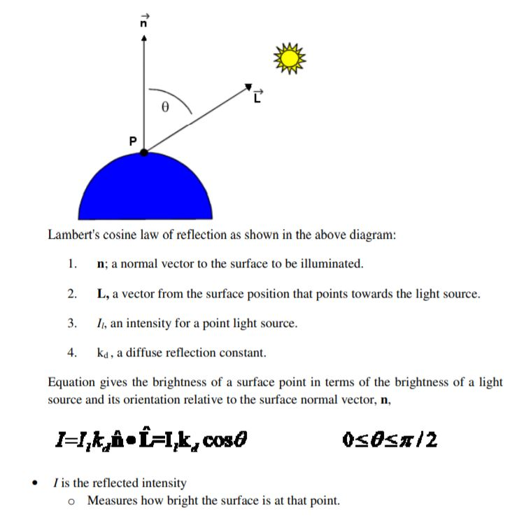
Diffuse illumination

Slide 64
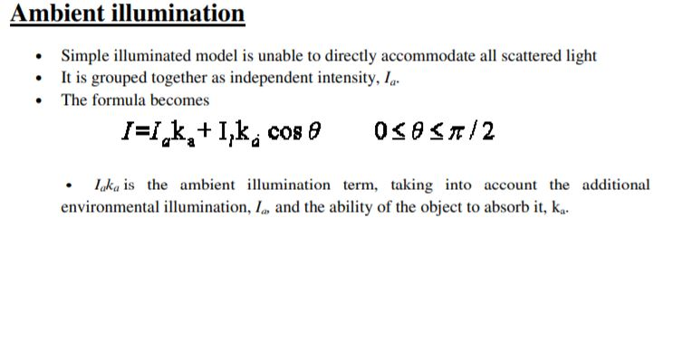

Slide 65
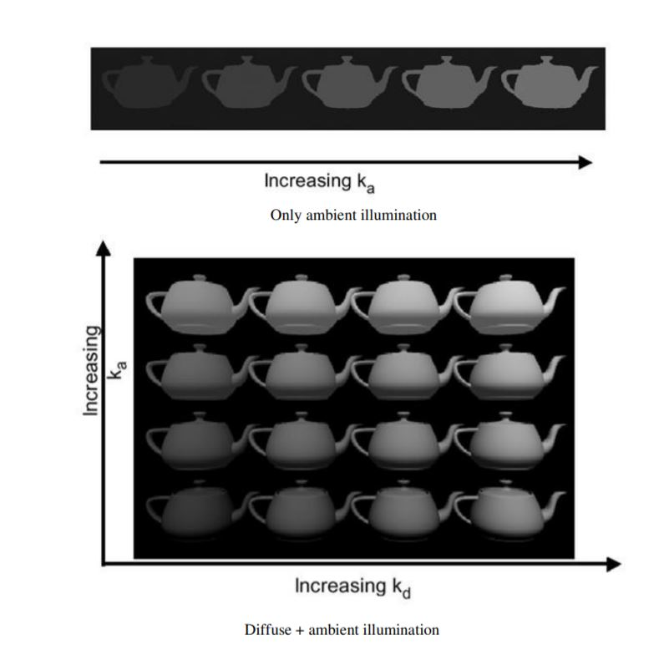

Slide 66
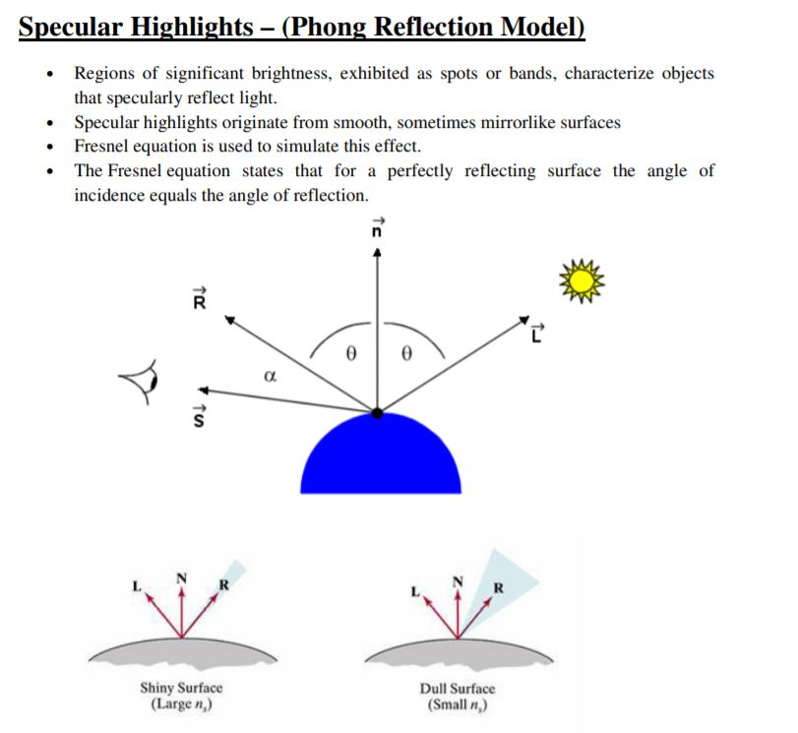

Slide 67
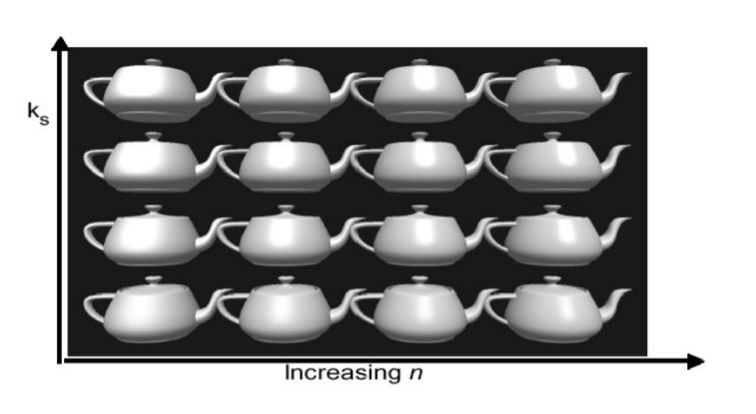

Slide 68
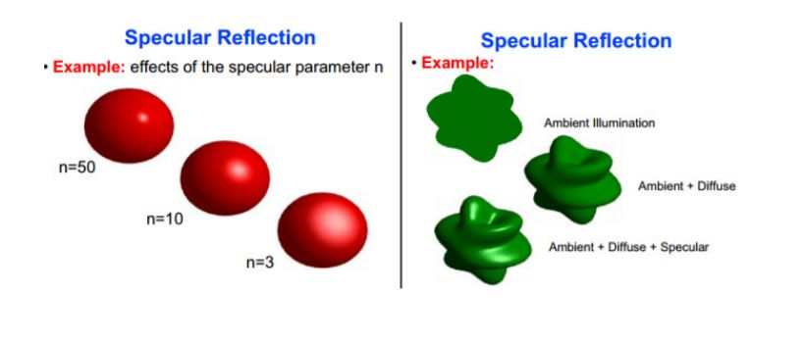

Slide 69
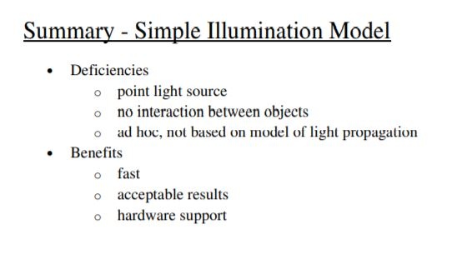

Slide 70
POLYGON RENDERING METHODS
Flat Shading (also known as faceted shading):
Shades each polygon of an object based on the angle between the polygon's surface normal and the direction of the light source.
•A single intensity is calculated for each surface polygon
• Fast and simple method
• Gives reasonable result only if all of the following assumptions are valid:
– The object is a polyhedron
– Light source is far away from the surface so that N•L is constant over each polygon
– Viewing position is far away from the surface so that V•R is constant over each polygon
Disadvantage - it gives low-polygon models a faceted look. Sometimes this look can be advantageous though, such as in modelling boxy objects. Artists sometimes use flat shading to look at the polygons of a solid model they are creating.

Slide 71
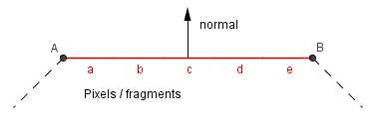
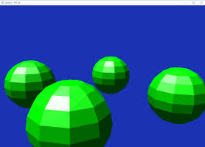
Flat Shading (per polygon)
It defines a single color for a face

Slide 72
Gouraud Shading
Gouraud shading (Henri Gouraud, 1971) is used to achieve smooth lighting on low-polygon surfaces using the Lambertian diffuse lighting model.
1. Calculates the surface normals for the polygons.
2. Normals are then averaged for all the polygons that meet at each vertex to produce a vertex normal.
3. Lighting computations are then performed to produce intensities at vertices.
4. These intensities are interpolated along the edges of the polygons.
5. The polygon is filled by lines drawn across it that interpolate between the previously calculated edge intensities.
Advantage - Gouraud shading is superior to flat shading which requires significantly less processing than Gouraud, but gives low-polygon models a sharp, faceted look.

Slide 73
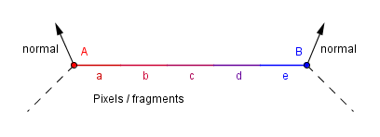
Gouraud Shading (per vertex)
There is a different normal per vertex is calculated and the color is calculated in the vertex shader.

Slide 74
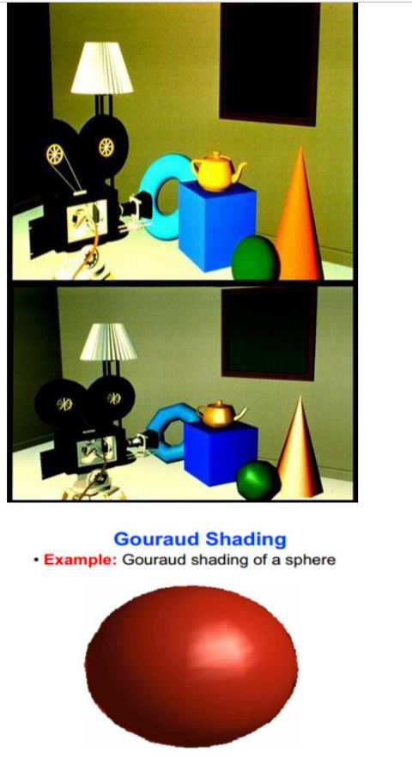

Slide 75
Phong Shading (Phong Interpolation Model)
• An improved version of Gouraud shading that provides a better approximation to the Phong shading model.
• Main problem with Gouraud shading - when a specular highlight occurs near the center of a large triangle, it will usually be missed entirely. Phong shading fixes the problem.
1. Calculate the surface normals at the vertices of polygons in a 3D computer model.
2. Normals are then averaged for all the polygons that meet at each vertex.
3. These normals are interpolated along the edges of the polygons.
4. Lighting computations are then performed to produce intensities at positions along scanlines.

Slide 76
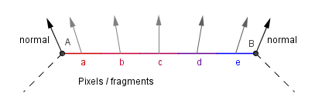
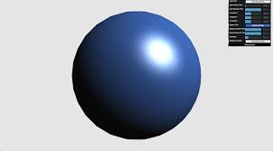
Phong Shading (per fragment)
The normal from the vertices is interpolated. Color is calculated per fragment, taking into account the interpolated normal.

Slide 77
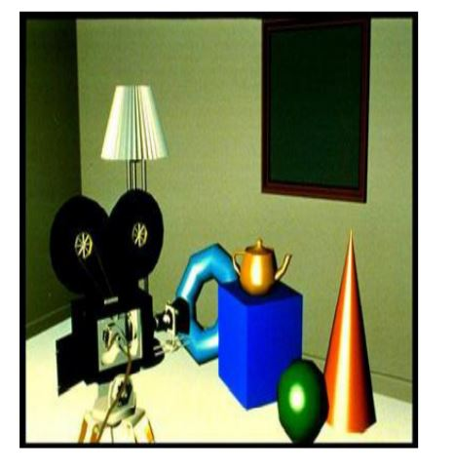

Slide 78
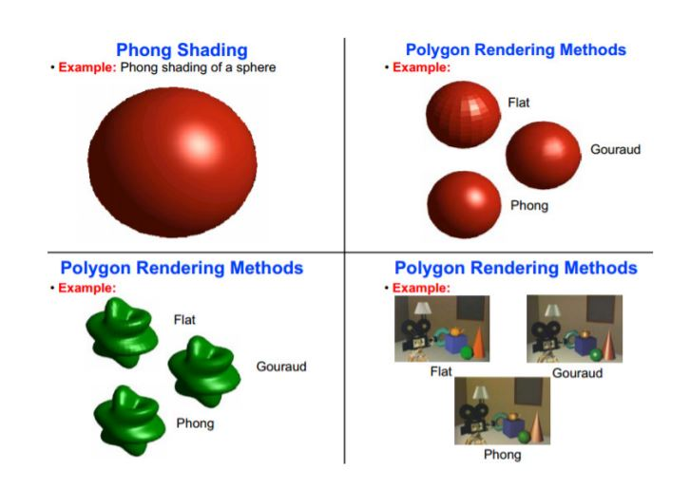

Slide 79
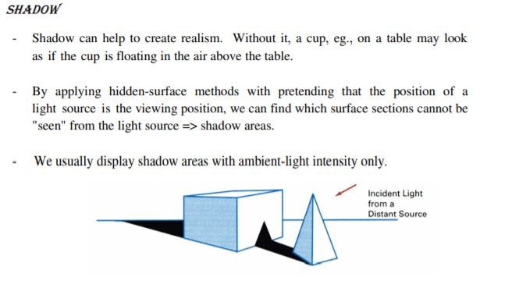
Other Effects

Slide 80
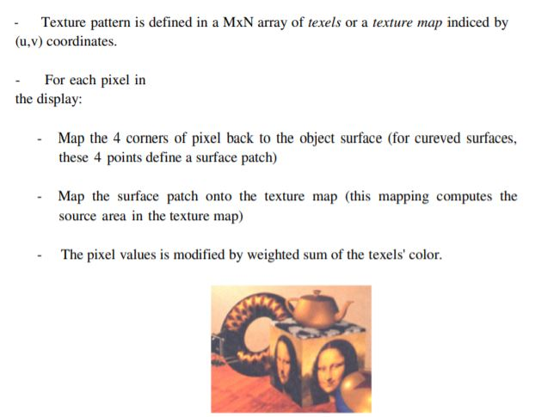
TEXTURE MAPPING
a photograph of real texture is input into the computer and mapped onto the object surface to create the texture for the object.

Slide 81
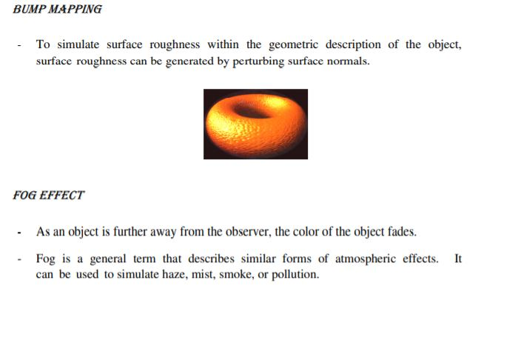

Slide 82
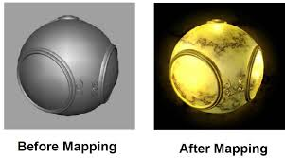
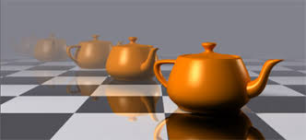
Texture mapping
Fog effect

Slide 83
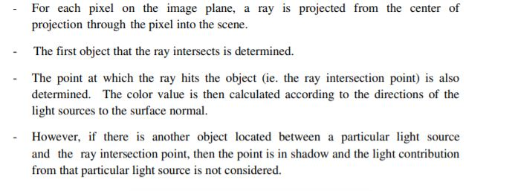
RAY TRACING METHODS

Slide 84
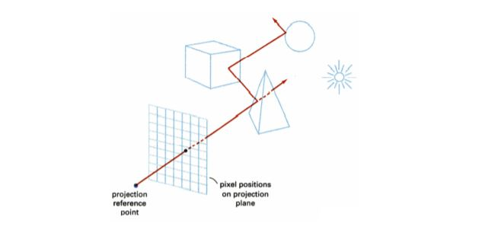


Slide 85


Slide 86
The point at which the reflected ray hits the second object are determined and the color value is again calculated in a similar way as the first object.
The reflected ray is then reflected again from the second object. This process will continue until the color contribution of an intersected object is too small to be considered.
In practical situation, se would specify the maximum number of reflections that a pixel can make to prevent spending too much processing at a particular pixel.
All the color values calculated from the intersected objects will be weighted by the attenuation factors (which depend on the surface properties of the objects) and added up to produce a single color value. This color value becomes the pixel value.
Because ray-tracing method calculates the intensity value for each pixel independently, we can consider specular reflection and refraction in the calculation.
The major problem of this method, however, is that it requires a lot of computations and therefore this method is slow

Slide 87

To calculate the color of a pixel, consider the following diagram:

Slide 88
Assume that surfaces S1 and S2 have reflective indices 1 and 2 respectively.
Given the surface normal vector, N1, and the light vector, L1, of surface S1, we can calculate the color, C1, of the surface at the point where the eye ray, E1 intersects the surface.
Similarly, given the surface normal vector, N2, and the light vector, L2, of surface S2, we can calculate the color, C2, of the surface at the point where the eye ray, E2 intersects the surface.
The color for the pixel is then calculated as: Cp= C1 + C2 + …

Slide 89

Radiosity
Consider the diagram, assuming that all 3 surfaces are matte. Although A reflects light with equal intensity to B and C, B would receive more light energy than C because B has a smaller angle of incident (ie. higher cos ).

Slide 90
Radiosity is developed to model this kind of light interaction between surfaces.
The algorithm is based on the theory of the conservation of energy.
In a closed environment such as a room, the rate at which energy leaves a surface, called its radiosity, is the sum of the rates at which the surface emits energy and it reflects (or transmits) energy from other surfaces.

Slide 91

To simplify the calculation, all surfaces in the scene are broken into small patches. Each of which is assumed to be of finite size, emitting and reflecting light uniformly over its entire area.

Slide 92


Slide 93
COLOUR IMAGE PROCESSING
The human visual system can distinguish hundreds of thousands of different colour shades and intensities, but only around 100 shades of grey
Therefore, in an image, a great deal of extra information may be contained in the colour, and this extra information can then be used to simplify image analysis, e.g. object identification and extraction based on colour.
Three independent quantities are used to describe any particular colour.
The hue is determined by the dominant wavelength.
Visible colours occur between about 400nm (violet) and 700nm (red) on the electromagnetic spectrum, as shown in the below figure.

Slide 94


Slide 95
The saturation is determined by the excitation purity, and depends on the amount of white light mixed with the hue.
A pure hue is fully saturated, i.e. no white light mixed in.
Hue and saturation together determine the chromaticity for a given colour.
Finally, the intensity is determined by the actual amount of light, with more light corresponding to more intense colours.

Slide 96
Achromatic light has no colour - its only attribute is quantity or intensity.
Greylevel is a measure of intensity.
The intensity is determined by the energy, and is therefore a physical quantity.
On the other hand,brightness or luminance is determined by the perception of the colour, and is therefore psychological.
Colour depends primarily on the reflectance properties of an object.

Slide 97
We see those rays that are reflected, while others are absorbed.
However, we also must consider the colour of the light source, and the nature of human visual system.
For example, an object that reflects both red and green will appear green when there is green but no red light illuminating it, and conversely it will appear red in the absense of green light.
In pure white light, it will appear yellow (= red + green)

Slide 98

Tristimulus theory of color perception
The human retina has 3 kinds of cones
The response of each type of cone as a function of the wavelength of the incident light is shown in figure
The peaks for each curve are at 440nm (blue), 545nm (green) and 580nm (red).

Slide 99
CIE primaries
The tristimulus theory of colour perception seems to imply that any colour can be obtained from a mix of the three primaries, red, green and blue, but although nearly all visible colours can be matched in this way, some cannot.
However, if one of the primaries is added to one of these unmatchable colours, it can be matched by a mixture of the other two, and so the colour may be considered to have a negative weighting of that particular primary.
In 1931, the Commission Internationale de l'Éclairage (CIE) defined three standard primaries, called X, Y and Z, that can be added to form all visible colours.

Slide 100
The primary Y was chosen so that its colour matching function exactly matches the luminous-efficiency function for the human eye, given by the sum of the three curves in the below figure
The CIE Chromaticity Diagram showing all visible colours.
x and y are the normalised amounts of the X and Y primaries present, and hence z = 1 - x - y gives the amount of the Z primary required.
Chromaticity depends on dominant wavelength and saturation, and is independent of luminous energy.
Colours with the same chromaticity, but different luminance all map to the same point within this region

Slide 101


Slide 102
The pure colours of the spectrum lie on the curved part of the boundary, and a standard white light has colour defined to be near (but not at) the point of equal energy x = y = z = 1/3.
Complementary colours, i.e. colours that add to give white, lie on the endpoints of a line through this point.
As illustrated in below figure, all the colours along any line in the chromaticity diagram may be obtained by mixing the colours on the end points of the line.

Slide 103

Mixing colours on the chromaticity diagram. All colours on the line IJ can be obtained by mixing colours I and J, and all colours in the triangle IJK can be obtained by mixing colours I, J and K.

